Slide 1
Balancing frontend and backend developement

Slide 2
Topics:
Introduction about fullstack:
Balancing Frontend and Backend:
Mastering the Backend:
Choosing the Right Technologies:
Testing and Debugging:
Continuous Learning and Improvement:
Conclusion:

Slide 3
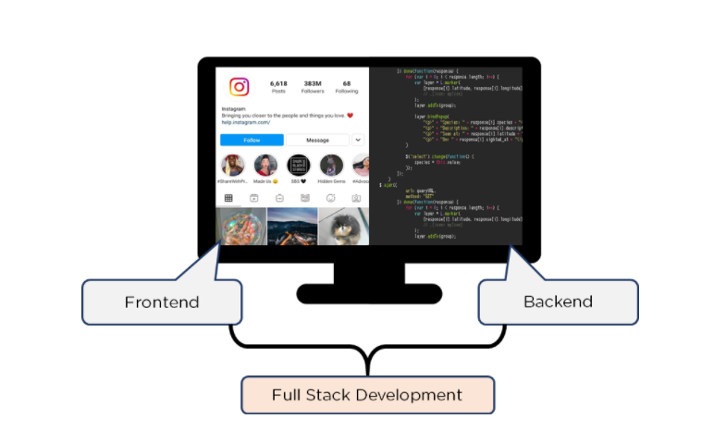
introduction
Full-stack development is like being a Renaissance artist, mastering both the art of the frontend and the science of the backend. It requires a unique blend of creativity and technical expertise to create seamless, functional, and user-friendly applications . In this blog post, we’ll explore the art of full-stack development , focusing on how to balance the frontend and backend aspects of a project.

Slide 4
Balancing Frontend and Backend
Understanding the Frontend: The frontend of a web application is what the user interacts with. It involves technologies like HTML, CSS, and JavaScript, as well as frontend frameworks like React, Angular, or Vue.js. A good frontend developer understands user interface design principles, accessibility, and responsive design.

Slide 5
Mastering backend
Choosing the Right Technologies
The backend is the engine that powers the application, handling tasks like data storage, security, and business logic. Backend development often involves languages like Node.js, Python, Ruby, or Java, as well as frameworks like Express, Flask, or Django. A backend developer needs to understanddatabases, APIs, and server-side programming concepts.
As a full-stack developer, you need to choose the right technologies for both the frontend and backend. This involves considering factors like performance, scalability, ease of development, and community support. Using frameworks and libraries can help streamline development and ensure consistency across the application.

Slide 6
Testing and Debugging:
Continuous Learning and Improvement
Full-stack developers need to be proficient in testing and debugging both frontend and backend code. This involves writing unit tests, integration tests, and end-to-end tests to ensure that the application functions as expected.It also involves debugging issues that arise during development or in production.
The field of full-stack development is constantly evolving, with new technologies and best practices emerging all the time. As a full-stack developer, it’s important to stay updated with the latest trends and technologies, and to continuously improve your skills.

Slide 7
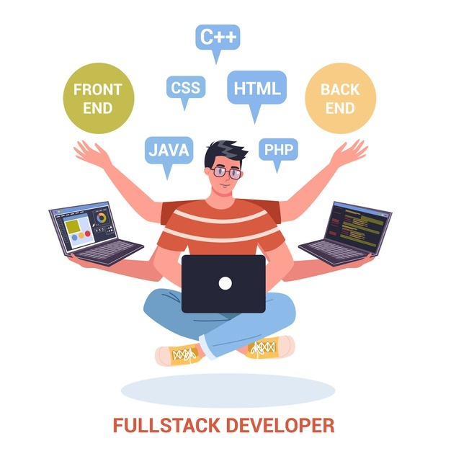
Conclusion:
Full-stack development is a challenging but rewarding field that requires a diverse skill set and a balance of creativity and technical expertise. By mastering both the frontend and backend aspects of development, you can create powerful, user-friendly applications that delight users and drive business success. So, embrace the art of full-stack development, hone your skills, and create amazing applications that make a difference!

